Slide 1

Introduction To Web Development
Notes:
Replace content with your name, GDG, and event date

Slide 2



Lakshay
Balaji
Reejh
Notes:
Introduce yourself.
Who are you? How’d you get into Polymer?

Slide 3
What is Node.js
“Node.js is a JavaScript runtime built on Chrome's V8 JavaScript engine. Node.js uses an non-blocking I/O model that makes it lightweight and efficient.”

Slide 4
NPM
NPM is the node package manager for NodeJS packages.
Installing a package:
npm install <package _name> -g(optional)
Uninstall a package:
npm uninstall <package_name>

Slide 5
Sync v/s Async
// Example 1 - Synchronous (blocks)
var result = database.query("SELECT * FROM hugetable");
console.log("Query finished");
console.log("Next line");
// Example 2 - Asynchronous (doesn't block)
database.query("SELECT * FROM hugetable", function(result) {
console.log("Query finished");
});
console.log("Next line");
OUTPUT:
Synchronous:
Query finished
Next line
Asynchronous:
Next line
Query finished

Slide 6
HTTP MODULE
const http = require('http')
const port = 3000
const requestHandler = (request, response) => {
console.log(request.url)
response.end('Hello Node.js Server!')
}
const server = http.createServer(requestHandler)
server.listen(port);

Slide 7
fs Module
Example: Reading File
var fs = require('fs');
fs.readFile('TestFile.txt', function (err, data) {
if (err) throw err;
console.log(data);
});
Example: Reading File Synchronously
var fs = require('fs');
var data =fs.readFileSync('dummyfile.txt', 'utf8');
console.log(data);

Slide 8
Example: Creating & Writing File
var fs = require('fs');
fs.writeFile('test.txt', 'Hello World!', function (err) {
if (err)
console.log(err);
else
console.log('Write operation complete.');
});
Example: Append File Content
var fs = require('fs');
fs.appendFile('test.txt', 'Hello World!', function (err) {
if (err)
console.log(err);
else
console.log('Append operation complete.');
});

Slide 9
Some Useful npm packages
Express
Unirest / Request
Mongoose / mongodb
Socket.io
Passport
EJS / PUG

Slide 10
Callback vs Promise
CALLBACK FUNCTION:
function two(){
return 2;
}
function x(y){
//execute y
return y();
}
console.log(x(two)); //2
USING PROMISES
function two(){
return 2;
}
function error(e){
console.log(e);
}
var promise = new Promise(function(callback, e){
console.log(callback());
});
promise.then(two, error);

Slide 11
Express
“Fast, minimalist web framework for Node.js”
Installing :
npm install express -g
Usage:
var express=require(‘express’);
var app=express();
app.get(‘/’, callback);
app.post(‘/url’, callback );
app.listen(3000);

Slide 12
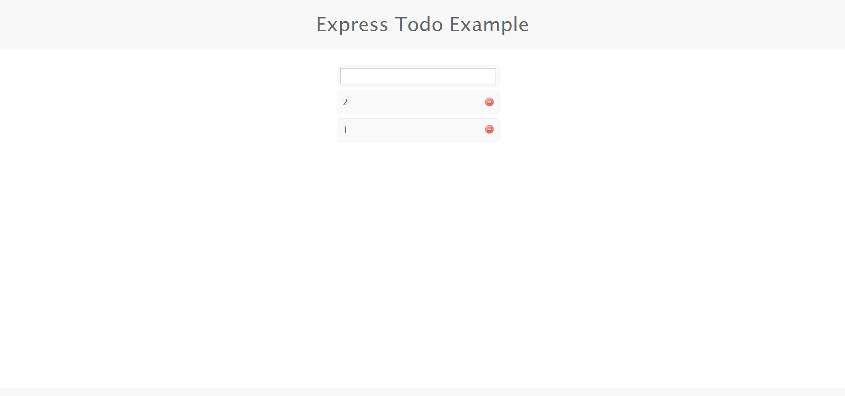
Simple TO-DO Web App

